Slide 1
CSE 220
Data Structures
Lecture 07:
Hashing and Hash Tables
Anwarul Bashir Shuaib [AWBS]
Lecturer
Department of Computer Science and Engineering
BRAC University

Slide 2
Need for Efficient Searching
Arrays: Fast access by index (arr[0], arr[1], …),
but slow to search by value (e.g., Is 'Alice' in this array?).
cat | bob | alice | eve | gold | brown
0 | 1 | 2 | 3 | 4 | 5

Slide 3
Need for Efficient Searching
Same goes for linked lists.
Find “alice” in this list ⇒ O(n)
head
cat
bob
gold
eve
alice
ruby
NULL

Slide 4
Need for Efficient Storing
Add a new name “russel” at position 2 ⇒ O(n)
cat | bob | alice | eve | gold | brown
0 | 1 | 2 | 3 | 4 | 5
Same for linked lists ⇒ O(n)

Slide 5
Fast Searching and Storing
What if the array is sorted?
  For searching, best we can do is O(logn)
  Insertion / deletion of an element is still O(n), as we need to shift elements to make room / fill up empty space

Slide 6
Problem with Arrays/Lists
Arrays: Fast access by index, but slow to search by value (e.g., "Is 'Alice' in this array?").
Lists: Easy to add/remove, but slow to search (check every item).
Solution: What if we could turn a key (like "Alice") into an index for instant access?
Hash tables are extremely efficient with both storing and retrieving
Both operations are O(1)!

Slide 7
Hash functions
Definition: A function that converts any key (text, number, etc.) into a number (hash code).
Example:
Hash("Alice") → 140 → Index = 140 % 6 → Index 2
Key Point: Same key → same index every time!
cat | bob | alice | eve | gold | brown
0 | 1 | 2 | 3 | 4 | 5
Key → Hash Function → Hash Code (e.g., 140).
Hash Code % Table Size → Index (e.g., 140 % 6 = 2).

Slide 8
More on hash functions
Hash functions should be as different as possible for different keys
  We call this property collision resistance
  We try to come up with such hash functions so that it is extremely difficult to find two different inputs, say x and y, that produces same hash code, e.g: hash(x) == hash(y)
Hash functions is a one-way function (you cannot decode the key from the hash code)
For a given key (say, “alice”), hash functions will always produce the same hash code (for example, hash(“alice”) = 140)

Slide 9
Key-Value Mapping
You have a list of user names, and their phone numbers.
How would you store this information?
Username ⇒ Key
Phone number ⇒ Value
5513 | 2231 | 5123 | 6712 | 9224 | 5215
cat | bob | alice | eve | gold | brown

Slide 10
Key-Value Mapping
You have a list of user names, and their phone numbers.
How would you store this information?
Username ⇒ Key
Phone number ⇒ Value
5513 | 2231 | 5123 | 6712 | 9224 | 5215
cat | bob | alice | eve | gold | brown
Values
Keys
Hash(key) % Table size = Index

Slide 11
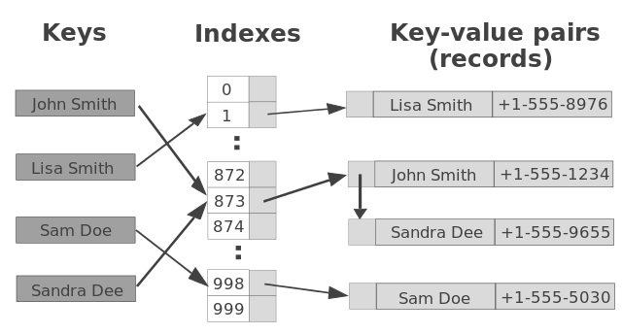
Hash Table
We have infinitely possible keys, but limited memory
We create a fixed sized array (say 1000), and map all possible (key, value) pairs in that array

Slide 12
Hash Table
We store each (k,v) pair in a linked list. Each cell in the array is a linked list head.
Whenever multiple keys map to the same position (collision occurs), we append the (k,v) pair in the linked list at that position.

Slide 13
Practice
You have the keys 41, 18, 28, 36, 10, 90, 12, 54, 38, 25
Hash table with size 13
h(k) = k % 13
Draw the final hash table after inserting the keys

Slide 14
Practice
Step 1: Find indices for each keys
k | h(k) = k % 13
41 | 2
18 | 5
28 | 2
36 | 10
10 | 10
90 | 12
12 | 12
54 | 2
38 | 12
25 | 12
You can perform modulo on your calculator

Slide 15
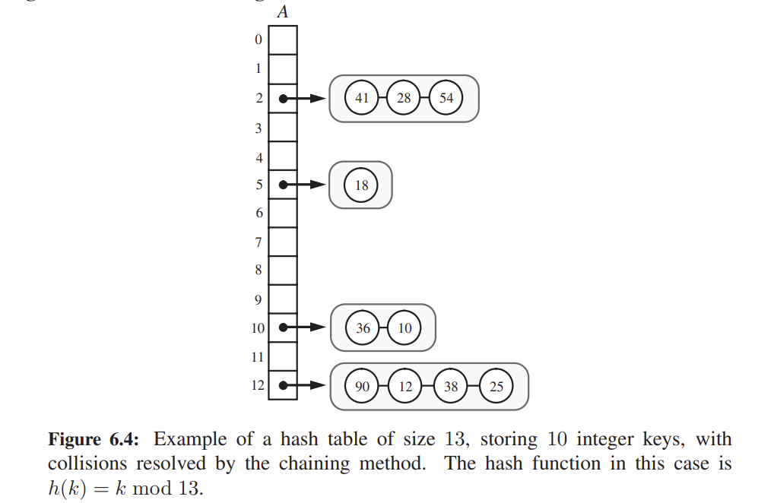
Step 2: Draw the table

Slide 16
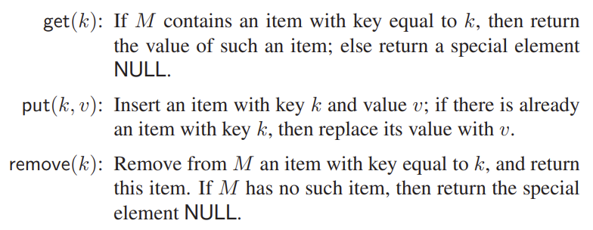
Operations on Hash Tables
Denote the hash table by “M”

Slide 17
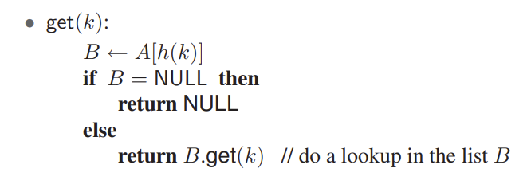
Retrieving an item
find(k)

Slide 18
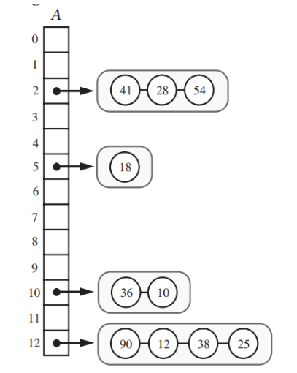
Retrieving an item
hashtable.get(14)
Compute h(14) = 14 % 13 = 1

Slide 19
Retrieving an item
hashtable.get(14)
Compute h(14) = 14 % 13 = 1
Access A[1]

Slide 20
Retrieving an item
hashtable.get(14)
Compute h(14) = 14 % 13 = 1
Access A[1]
Since A[1] is empty (null), 14 does not exist.

Slide 21
Retrieving an item
hashtable.get(38)
Compute h(38) = 38 % 13 = 12

Slide 22
Retrieving an item
hashtable.get(38)
Compute h(38) = 38 % 13 = 12
Access the head at A[12]

Slide 23
Retrieving an item
hashtable.get(38)
Compute h(38) = 38 % 13 = 12
Access the head at A[12]
Perform a linear search starting from the head until you find the element

Slide 24
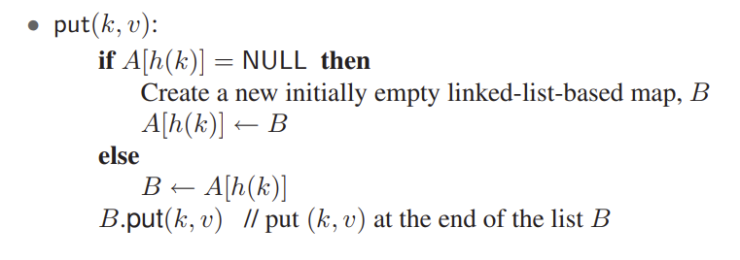
Insertion
append(k)

Slide 25
Insertion
hashtable.put(20, 20) // key and value are the same
Compute h(20) = 20 % 13 = 7

Slide 26
Insertion
hashtable.put(20, 20) // key and value are the same
Compute h(20) = 20 % 13 = 7
Insert element 20 at A[7]
20

Slide 27
Insertion
hashtable.put(33, 33) // key and value are the same
Compute h(33) = 33 % 13 = 7
20

Slide 28
Insertion
hashtable.put(33, 33) // key and value are the same
Compute h(33) = 33 % 13 = 7
Append 33 at A[7]
20
34

Slide 29
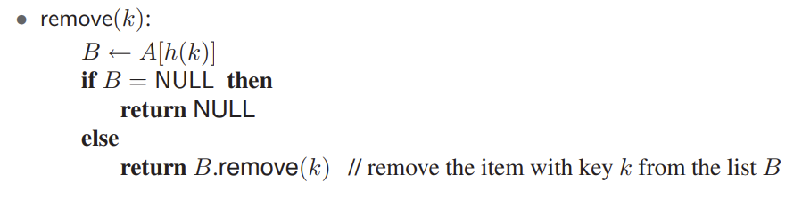
Removal
delete(k)

Slide 30
Insertion
hashtable.remove(35)
Compute h(35) = 35 % 13 = 8
Nothing to remove at A[8], so do nothing
20
34

Slide 31
Insertion
hashtable.remove(20)
Compute h(20) = 20 % 13 = 7
Access the head at A[7]
Keep traversing the list at A[7] until you find 20, if found then remove it.
20
34

Slide 32
Insertion
hashtable.remove(20)
Compute h(20) = 20 % 13 = 7
Access the head at A[7]
Keep traversing the list at A[7] until you find 20, if found then remove it.
34

Slide 33
Why Constant Time?
Best Case:
Perfect hash function → No collisions → O(1) time.
Average Case:
Good hash function + balanced table → Short linked lists → ≈O(1).
Key Idea: Even with a few collisions, chains stay small if the table is large enough.

Slide 34
Summary
Hash Tables = Speed + Simplicity:
Hash function → instant index.
Forward chaining → handle collisions.
Result: Fast insert, search, delete!
Real-World Use Cases: Databases, caches, spell-checkers.

Slide 35
Exercise
Given an unsorted array of integers, find pairs (a,b) such that a+b = 0 in O(n) time.
  Insert items into hash table ⇒ O(n)
  For each item x, find its equivalent negative pair (-x). If found, print (x, -x) ⇒ O(n)
  Overall time: O(n)

